Slide 1













VETCOMPASS
VET Teachers' Transversal Skills
Competence Assessment System
Module 1: Inclusive & Learner-Centred Teaching

Slide 2



Introduction & Learning Objectives
Inclusive and learner-centred teaching is the ability to design and deliver vocational learning that responds to diverse learner needs while staying aligned to occupational standards.
Despite VET’s potential to empower traditionally excluded groups, many learners still face systemic barriers. Inclusion is an ongoing professional practice — not a fixed destination.
By the end of this module, you will learn to recognise the barriers that exclude learners, apply practical strategies for differentiation and inclusive teaching, and connect your classroom practice to the broader transversal skills your learners need to succeed.

Slide 3

Section 1: Understanding Inclusion in VET
Inclusion means creating the conditions in which every learner can participate, progress, and succeed, regardless of background, ability, or starting point.
Exclusion in VET rarely happens all at once. It builds through small, accumulated barriers that compound over time.
Recognising these barriers is the first step. Addressing them requires deliberate change at the level of teaching practice- not just policy.

Slide 4




5 Common Barriers to Inclusion in VET
Physical — inaccessible facilities, equipment or environments
Attitudinal — low expectations, unconscious bias or deficit thinking
Institutional — inflexible timetabling, limited support or assessment formats that disadvantage learners
Curriculum — content and delivery that assumes a single learner profile
Economic — costs of materials, transport or equipment that some learners cannot meet
Barriers
Institutional
Attitudinal
Curriculum
Physical

Slide 5





Inclusion Self-Assessment (Rate 1–5)
Inclusive Teaching (1–3)
Inclusive Assessment (4–5)
Rate 1–5:
I know which learners face the greatest barriers.
I design tasks that can be accessed at different levels without lowering standards.
I check for understanding in ways that do not single learners out.
Rate 1–5:
I use a range of formats and methods across a programme, not just one approach.
I review whether my assessments disadvantage any learner group.

Slide 6

Section 2: Learner-Centred Teaching in Practice
Learner-centred teaching shifts focus from what the trainer delivers to what the learner experiences and achieves. It means finding the route to occupational standards that works for each learner.
Key approaches:
build from prior knowledge
offer choice
Scaffold tasks without removing challenge
give feedback on progress
create space for self-reflection
A learner needs assessment identifies starting points, strengths, and barriers. It does not require a formal tool — it requires deliberate attention early in a programme.

Slide 7






Learner-Centred Teaching: Key Approaches
Build on Prior Knowledge
Offer Choice
Scaffold Support
Reflect & Progress
Find out what learners already know and build from there. Use early tasks to reveal starting points and inform your planning.
Where possible, offer choice in how tasks are approached or demonstrated. This respects different learning modes.
Design tasks with multiple entry points. Reduce scaffolding as competence builds. Keep the standard the same for everyone.
Give feedback that tells learners where they are and what to do next. Create space for learners to reflect on their own growth.

Slide 8
Learner Needs Assessment: Key Questions
Prior Knowledge
Learning Mode
Barriers
Success Criteria
What does this learner already know or can they already do in this area?
What is their strongest mode of learning — observing, doing, reading, or discussing?
What barriers might affect their participation or progress in this programme?
What would success look like for this learner at the end of the programme?

Slide 9




Section 3: Differentiation Without Lowering Standards
Differentiate the Input
Present information in more than one format. Use demonstration alongside written instructions. Use visual prompts alongside verbal explanation.
Differentiate the Task
Design tasks with multiple entry points. A learner who needs more support starts with a guided version. A learner ready for extension moves to a more complex application.
Differentiate the Support
Vary how much guidance is available during a task. Scaffolding should decrease over time as competence builds.

Slide 10
Scenario Exercise: Differentiation in Action
The Quick Finishers
On Track Learners
Struggling Learners
Not Started Yet
Three are completing the practical task quickly and accurately. Prepare an extension challenge that adds complexity without changing the standard.
Four learners are progressing at the expected pace. Maintain the current task flow and monitor for any signs of drift or confusion.
Three are struggling with the sequence. Break the task into smaller steps. Offer a worked example or demonstration to reorient them.
Two have not started. Approach privately and one-to-one. Identify the barrier — is it confusion, confidence, or something else?

Slide 11


Scenario Exercise: Differentiation in Action
SCENARIO A group of twelve learners is working on a practical task. Three are finishing quickly and accurately. Four are on track. Three are struggling with the sequence. Two have not started.
Reflect on your response as the trainer:
What do you do in the next five minutes for each group?
How do you support the two who have not started without drawing attention to them?
What does the task need to look like next session to address what you observed?
How do you maintain the same standard for everyone while taking different routes?
Key principle: Differentiation becomes a skill when it is planned in advance, not improvised under pressure.

Slide 12
Section 4: Building an Inclusive VET Environment
Inclusive teaching does not happen in isolation. It is supported or undermined by the wider environment — the physical space, the institutional culture, and the relationships within a team. VET teachers can influence all three, even without institutional authority.
The Inclusive Classroom Environment
A VET learning environment communicates expectations before a word is spoken. Learners read the space and decide whether they belong in it. Practical steps include: displaying work from a range of learner backgrounds; using language that assumes competence rather than deficit; setting group norms from the start; making support resources visible and accessible.

Slide 13
Why Inclusion Matters: Transversal Skills
Confidence
Communication
Problem-Solving
Resilience
Develops when learners feel safe enough to participate without fear of judgement.
Improves when all learners have genuine opportunities to contribute to tasks and discussion.
Strengthens when tasks are accessible and challenge is appropriately pitched for each learner.
Builds when learners experience difficulty in a supportive environment, not an excluding one.

Slide 14

Teacher Strategies to Strengthen Inclusive Practice
VET trainers can develop this skill by:
Completing a learner needs assessment at the start of each new programme
Reviewing one session per term and asking: who was least visible? What would have helped them?
Working with colleagues to share differentiation approaches that have been effective
Using the UNESCO-UNEVOC framework to audit their institution’s current inclusion strengths and gaps
Inclusive teaching is not a separate task added to everything else. It is a way of doing everything else with greater awareness

Slide 15

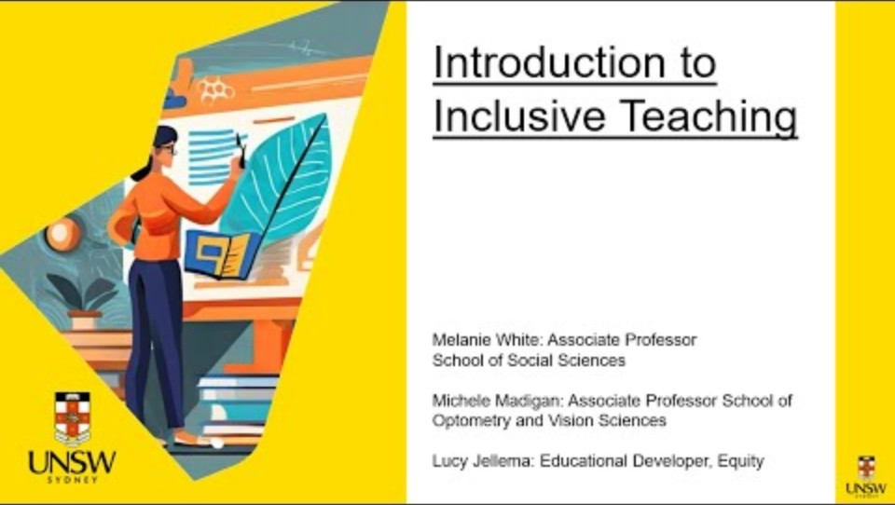
WATCH
Check out the following YouTube video for a guide on how to make your classroom more inclusive using a universal design approach to learning.
Video can also be accessed at:
https://www.youtube.com/watch?v=RCHETWoXD_E

Slide 16
Teacher Strategies to Strengthen Inclusive Practice
Learner Needs Assessment
Complete a learner needs assessment at the start of each new programme to map starting points, strengths, and potential barriers.
Session Review
Review one session per term and ask: who was least visible? What would have helped them participate more fully?
Peer Collaboration
Work with colleagues to share differentiation approaches. Use the UNESCO-UNEVOC framework to audit your institution’s inclusion strengths.

Slide 17



Thank You
For Your Attention
Contact Us
www.vetcompass.eu

